Slide 1
Master Theorem Application For Logarithmic Combine Cost
SHAHANAJ. C
192372292

Slide 2
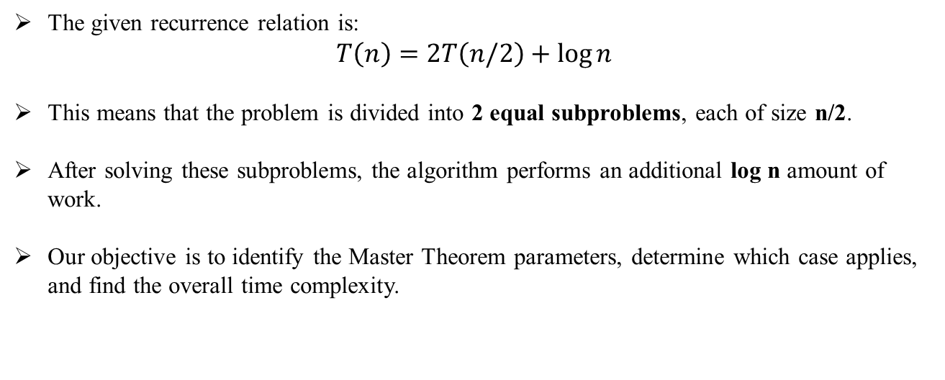
Problem Statement
The given recurrence relation is:
$$T\left(n\right)=2T\left(n/2\right)+\log{n}$$
This means that the problem is divided into 2 equal subproblems, each of size n/2.
After solving these subproblems, the algorithm performs an additional log n amount of work.
Our objective is to identify the Master Theorem parameters, determine which case applies, and find the overall time complexity.
Notes:
Image source: https://image1.slideserve.com

Slide 3
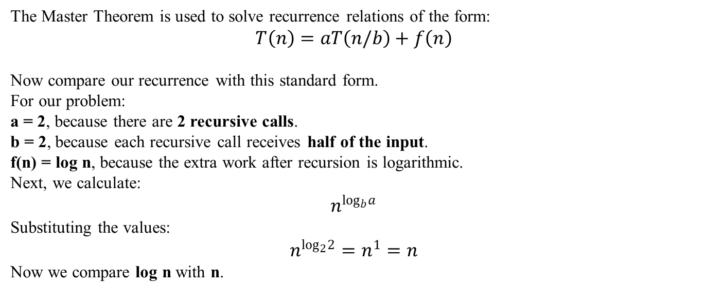
Algorithm Overview
The Master Theorem is used to solve recurrence relations of the form:
$$T\left(n\right)=aT\left(n/b\right)+f\left(n\right)$$
Now compare our recurrence with this standard form.
For our problem:
a = 2, because there are 2 recursive calls.
b = 2, because each recursive call receives half of the input.
f(n) = log n, because the extra work after recursion is logarithmic.
Next, we calculate:
$$n^{\log_{b}a}$$
Substituting the values:
$$n^{\log_{2}2}=n^{1}=n$$
Now we compare log n with n.
Notes:
Image source: https://image1.slideserve.com

Slide 4
Algorithm or Pseudocode
The solution follows these steps:
Identify a, b, and f(n).
Compute n^(log_b a).
Compare f(n) with n^(log_b a).
Apply the appropriate Master Theorem case.
Determine the final complexity.
This systematic approach helps us solve any divide-and-conquer recurrence
Notes:
Image source: https://image1.slideserve.com

Slide 5
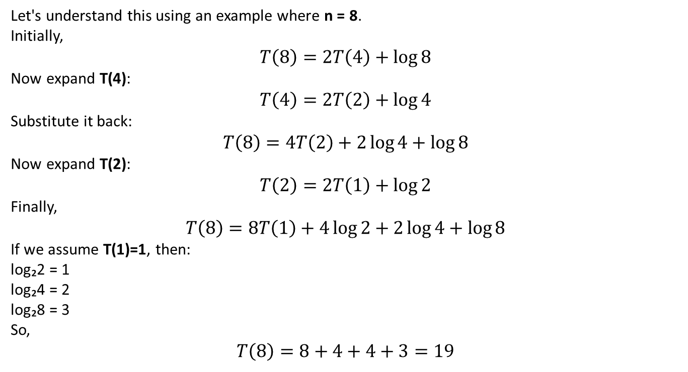
Working Example
Let's understand this using an example where n = 8.
Initially,
$$T\left(8\right)=2T\left(4\right)+\log{8}$$
Now expand T(4):
$$T\left(4\right)=2T\left(2\right)+\log{4}$$
Substitute it back:
$$T\left(8\right)=4T\left(2\right)+2\log{4}+\log{8}$$
Now expand T(2):
$$T\left(2\right)=2T\left(1\right)+\log{2}$$
Finally,
$$T\left(8\right)=8T\left(1\right)+4\log{2}+2\log{4}+\log{8}$$
If we assume T(1)=1, then:
log₂2 = 1
log₂4 = 2
log₂8 = 3
So,
$$T\left(8\right)=8+4+4+3=19$$
Notes:
Image source: https://image1.slideserve.com

Slide 6
Complexity Analysis
For the recurrence T(n) = 2T(n/2) + O(log n), identify a = 2, b = 2, and f(n) = O(log n).
Compute n^{log_b a} which equals n^{log_2 2} = n^1 = n.
Compare f(n) with n^{log_b a} to determine the case of the theorem.
Notes:
Image source: https://www.slidemake.com

Slide 7
Comparative Analysis
Since f(n) = O(log n), which grows more slowly than n^{log_b a} = n, it falls under Case 1 of the Master Theorem.
Case 1 states that if f(n) = O(n^{log_b a - ε}) for some ε > 0, then T(n) = Θ(n^{log_b a}).
Therefore, T(n) = Θ(n).
Notes:
Image source: https://image1.slideserve.com

Slide 8
Applications
Recurrence relations like this are common in divide-and-conquer algorithms.
Applications include:
Merge Sort analysis
Binary tree algorithms
Parallel computing
Recursive searching
Algorithm performance analysis
The Master Theorem helps analyze these algorithms quickly.
Notes:
Image source: https://image1.slideserve.com

Slide 9
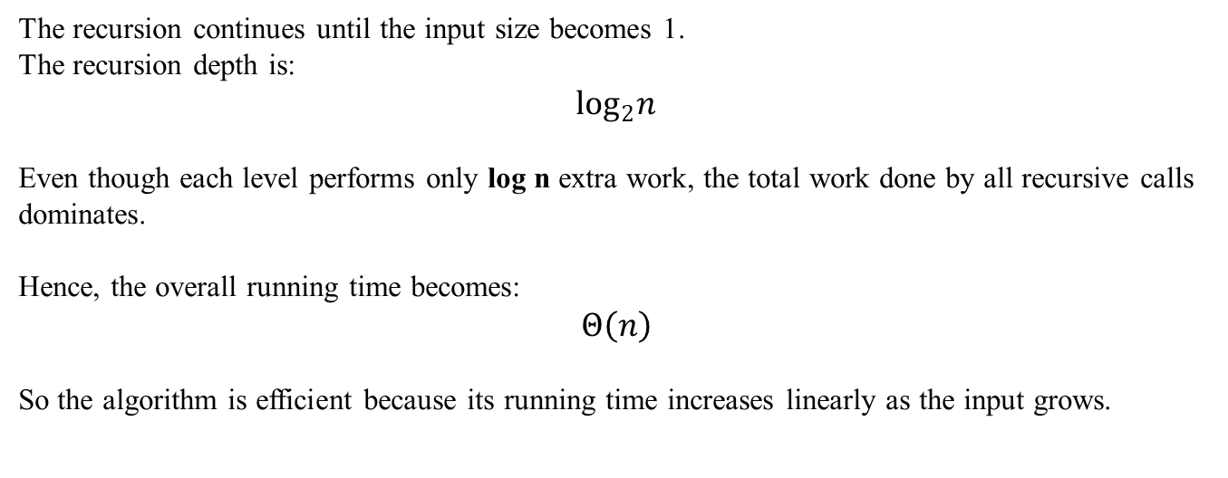
Results & Discussion
The recursion continues until the input size becomes 1.
The recursion depth is:
$$\log_{2}n$$
Even though each level performs only log n extra work, the total work done by all recursive calls dominates.
Hence, the overall running time becomes:
$$Θ\left(n\right)$$
So the algorithm is efficient because its running time increases linearly as the input grows.
Notes:
Image source: https://image.slidesharecdn.com

Slide 10
Conclusion & References
Conclusion:
Identified a = 2, b = 2, f(n) = log n
Applied Master Theorem Case 1
Final Time Complexity:
References:
Introduction to Algorithms – Cormen
Fundamentals of Computer Algorithms – Horowitz & Sahni
Notes:
Image source: https://image1.slideserve.com

Slide 11
THANK YOU

